Slide 1
THE BIBLE IN THE BRITISH MUSEUM Part 1

Slide 2
Purpose of this series
Support the Bible
Real place
Real people
Real events
Accurate descriptions
Better understand the Bible
To understand that more knowledge of history enriches our understanding of the Bible.

Slide 3
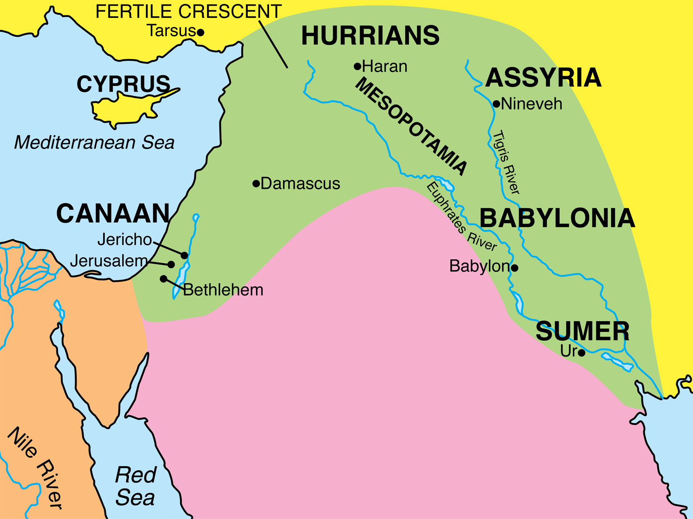

Slide 7
WRITING IN 3 LANGUAGES
John 19:20-22
20 Therefore many of the Jews read this inscription, for the place where Jesus was crucified was near the city; and it was written in Hebrew, Latin and in Greek.
21 So the chief priests of the Jews were saying to Pilate, “Do not write, ‘The King of the Jews’; but that He said, ‘I am King of the Jews.’ ”
22 Pilate answered, “What I have written I have written.”

Slide 12
“I am Nebuchadnezzar, king of Babylon… the eldest son of Nabopolassar”
Mentioned 91 times in the Bible

Slide 14
BLACK OBELISK
Describes the victories of the Assyrian king, Salmaneser III.
Mentions defeat of Ben-Hadad of Damascus (mentioned 27 times in the Bible - )
Mentions defeat of Hazael of Damascus (II Kings 8:7-15)

Slide 16
BLACK OBELISK
“Tribute of Yaua, son of Humri: I received silver, gold…”
Yaua is Jehu (II Kings 9-10)
Humri is Omri (I Kings 16:16-30)

Slide 17
References:
Ben-Hadad
and
Ahab, King of Israel
(Mentioned 94 times in the Bible)
Notes:
One part of the “Stele of Three kings”. This depicts Shalmaneser III. In his records, Ahab is menioned, besides Jehu, Omri, Ben-Hadad and Hazael, Ahab is also menioned.

Slide 18
Notes:
Wall relief.

Slide 19
Tiglath-Pilesar III (or Pul) II Kings 15:19

Slide 20
Picture of Israelites bringing tribute
(II Kings 15:17-19)

Slide 21
Notes:
Replica of the Balawat Gate – Gates of Assyria leading to the palace. Depicts the gruesome nature of the kings.
In the museum, to the right, there are the remnants of the metal cross bars (see next picture for close up of the replicas).

Slide 23
The King of Assyria boasted:
“I built a pillar over against the city gate, and I flayed all the chief men who had revolted, and I covered the pillar with their skins. Some I walled up within the pillar on stakes, and others I bound round the pillar; and I cut off the limbs of the officers who had rebelled. From some I cut off their hands and from others I cut off their noses, their ears, and their fingers, of many I put out the eyes. Their young men and maidens I burned in the fire. The rest of them I consumed with thirst in the desert of the Euphrates.”

Slide 24
This was the reputation of the kings of Assyria.
Some violence of this nature is depicted on the imposing doors.
“Arise, go to Nineveh the great city and cry against it, for their wickedness has come up before Me.” (Jonah 1:3)
Ever wonder why Jonah was so hesitant to go to Nineveh?

Slide 25
Notes:
Room with Assyrian wall decorations depicting the Royal hunt. The next pictures focus on the wall to the right.

Slide 31
NAHUM 2:8-13 8 Though Nineveh was like a pool of water throughout her days, Now they are fleeing; “Stop, stop,” But no one turns back. 9 Plunder the silver! Plunder the gold! For there is no limit to the treasure— Wealth from every kind of desirable object. 10 She is emptied! Yes, she is desolate and waste! Hearts are melting and knees knocking! Also anguish is in the whole body And all their faces are grown pale!

Slide 32
NAHUM 2:8-13 11 Where is the den of the lions And the feeding place of the young lions, Where the lion, lioness and lion’s cub prowled, With nothing to disturb them? 12 The lion tore enough for his cubs, Killed enough for his lionesses, And filled his lairs with prey And his dens with torn flesh. 13 “Behold, I am against you,” declares the LORD of hosts. “I will burn up her chariots in smoke, a sword will devour your young lions; I will cut off your prey from the land, and no longer will the voice of your messengers be heard.”

Slide 33
Isaiah 20:1
“In the year that the commander came to Ashdod, when Sargon the king of Assyria sent him and he fought against Ashdod and captured it,”
Notes:
Sargon was long thought to be fictional because only this one verse in the Bible recorded his name. Later, he was discovered to be a hugely powerful king of Assyria. There’s no questions about his existence any more!

Slide 36
SARGON’S ACT
Sargon writes that in the first year of his reign he conquered Samaria and replaced the inhabitants with peoples from other nations.
The Bible also records this. “The king of Assyria brought men from Babylon and from Cuthah and from Avva and from Hamath and Sepharvaim, and settled them in the cities of Samaria in place of the sons of Israel. So they possessed Samaria and lived in its cities.” (II Kings 17:24)

Slide 37
Notes:
Human headed, bull figures (with wings). These were guardians of Sargon’s palace
Sennacherib, according to his grandson, was assassinated between two Colossi - likely statues of this nature.

Slide 38
Notes:
This one is human headed, but not a bull. Those are clawed feet. Maybe a lion with wings and a human head?
Go back and read Ezekiel and Revelation with statues like this in mind and suddenly the imager that is used isn’t so bizarre. These beasts and creatures in heaven and in throne rooms were things the people of ancient times were quite used to.

Slide 39
From the Palace of Esarhaddon
II Kings 19:36-37
36 So Sennacherib king of Assyria departed and returned home, and lived at Nineveh.
37 It came about as he was worshiping in the house of Nisroch his god, that Adrammelech and Sharezer killed him with the sword; and they escaped into the land of Ararat. And Esarhaddon his son became king in his place.
Notes:
Another head from a human headed bull statue. This was found in the palace of Esarhaddon

Slide 40
Under a statue like these…
This inscription was found
Notes:
Human headed, bull figures (with wings). These were guardians of Sargon’s palace
Sennacherib, according to his grandson, was assassinated between two Colossi - likely statues of this nature.

Slide 41
Notes:
Faded inscription details the tribute that Hezekiah paid to Sennacherib, King of Assyria.

Slide 42
TRIBUTE FROM HEZEKIAH
The inscription says that Hezekiah paid 800 talents of silver and 30 talents of gold

Slide 43
TRIBUTE FROM HEZEKIAH
II Kings 18:13-16
13 Now in the fourteenth year of King Hezekiah, Sennacherib king of Assyria came up against all the fortified cities of Judah and seized them.
14 Then Hezekiah king of Judah sent to the king of Assyria at Lachish, saying, “I have done wrong. Withdraw from me; whatever you impose on me I will bear.” So the king of Assyria required of Hezekiah king of Judah three hundred talents of silver and thirty talents of gold.
15 Hezekiah gave him all the silver which was found in the house of the LORD, and in the treasuries of the king’s house.
16 At that time Hezekiah cut off the gold from the doors of the temple of the LORD, and from the doorposts which Hezekiah king of Judah had overlaid, and gave it to the king of Assyria.

Slide 44
DEALING WITH DISCREPANCIES
The inscription says that Hezekiah paid 800 talents of silver and 30 talents of gold
The Bible says he paid 300 talents of silver and 30 talents of gold
What gives?

Slide 45
DEALING WITH DISCREPANCIES
Maybe the Bible is wrong
Maybe Sennacherib exaggerated
Maybe it is a copy error
But eventually it was discovered that what really happened…
Assyria measures gold like Judah does.
Assyria measures silver differently
Who would have guessed that? But, it turns out there was no discrepancy at all.

