Slide 1
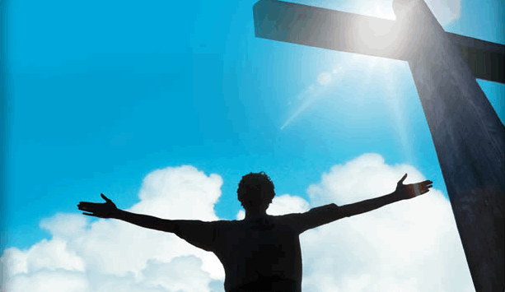

Class– Part one
Sermon - Part two
Notes:
SIMPLE LESSON/ that serves as sort of a “Reader’s Digest” Version of the Bible story!
The Bible is one of the most popular and yet misunderstood books in the world. It is possible to know a lot about the Bible without really understanding the Bible.
God could have written the Bible so that only Greek scholars or PhD theologians could have understood it. He could have written so that only rocket scientists could understand it.
Instead it was written so that it could only be understood by someone with the heart of a little child.
We are going to get in a helicopter and take a 20,000 foot view of the Bible. It is so easy in Bible study to see the “Trees” and miss the “forest.” This lesson is taking an ariel view and checking out the forest! Many folks have a hard time understanding because they don’t look at things in context and see who it all fits together. This “Big Picture Presentation” gives you frame work to understand all the Bible!
We will start by looking a few basic facts about the Bible.

Slide 2





The Incredible Book
66 Books: 39 OT + 27 NT
Written over 1500 years
(1450 BC – AD 100)
40 different authors
From 3 different continents, different nations, and varying cultures
Contains 3 different languages (Hebrew, Aramaic, Greek)
HEBREW
ARAMAIC
GREEK

Slide 3

1
40 Authors…6 Major Empires…
1500 Years… 66 Books…
3 Continents…3 Languages
One Theme!
amazing
God’s Plan of Redemption
Notes:
How could men have written this book? It would be impossible. There are many evidences we could look at in considering the case for a Creator: scientific, archiological, historical, etc. The internal evidence of this book is one of the most powerful evidences that this book was written by God.

Slide 4

An Urgent and Important Command
THE GREAT COMMISSION
“Go into all the world and
preach the gospel
to all creation.”
Mark 16:15

Slide 5
The Gospel –
The Power of God
“I am not ashamed of the gospel
for it is the
power of God
for salvation...”
Romans 1:16
Notes:
5
The gospel stands between man and salvation
The gospel is the power of God – not a fuzzy feeling, not money, or wealth or fame – but the gospel
<Here we learn additional information about the gospel>

Slide 6


THE GOSPEL –
A Message of Salvation
The gospel is a MESSAGE that is to be COMMUNICATED to every person - a message of SALVATION.
The Gospel is Objective Truth!
Notes:
It is objective truth . It is the truth that sets us free! (Jn 8:32).
We don’t go out and convert folks like Islam at the point of a sword, we simply share this powerful message that folks can either receive or reject. How one responds to the gospel is a critical turning point in each person’s life.
And interestingly, it must not just be believed, but obeyed!
<That is what 2 Thess 1:7-9 makes clear…>

Slide 7

The Gospel…Must be Obeyed
“...when the Lord Jesus will be revealed from heaven with His mighty angels in flaming fire, dealing out retribution to those who do not know God and to those who do not obey the gospel of our Lord Jesus. These will pay the penalty of eternal destruction, away from the presence of the Lord and from the glory of His power...”
do not obey the gospel
2 Thessalonians 1:7-9
Notes:
God will absolutely condemn anyone who rejects the gospel
The gospel is critically important
<TR> It gets even scarier

Slide 8

A Serious Warning…To Christians
“I am amazed that you are so quickly deserting Him who called you by the grace of Christ, for a different gospel; which is really not another; only there are some who are disturbing you and want to distort the gospel of Christ.
But even if we or an angel from heaven should preach a gospel other than
the one we preached to you,
let him be eternally condemned!”
Galatians 1:6-12 (see also Acts 20:28)
Notes:
Non –ecumenical. Promise keepers: It doesn’t matter what you believe as long as you belive in Jesus. Noooooo.

Slide 9
A Serious Warning…To Christians
“I am amazed that you are so quickly deserting Him who called you by the grace of Christ, for a different gospel; which is really not another; only there are some who are disturbing you and want to distort the gospel of Christ.
But even if we or an angel from heaven should preach a gospel other than
the one we preached to you,
let him be eternally condemned!”
POLITICALLY INCORRECT
RELIGIOUSLY INCORRECT
Galatians 1:6-12 (see also Acts 20:28)
Notes:
Non –ecumenical. Promise keepers: It doesn’t matter what you believe as long as you belive in Jesus. Noooooo.

Slide 10

The ONE Gospel
“I am amazed that you are so quickly deserting Him who called you by the grace of Christ, for a different gospel; which is really not another; only there are some who are disturbing you and want to distort the gospel of Christ.
But even if we or an angel from heaven should preach a gospel other than the one we preached to you, let him be eternally condemned!”
Galatians 1:6-12
How can I be certain?
Where would we start?
GOSPEL
Notes:
So, There is only one gospel and we have to get it right.
How can we be sure that we get this right, for we must get this right!
<The NT gives us a pointer or direction of where to begin to understand the theme of the Bible

Slide 11
Galatians 3:24
Also: Rom. 15:4
For whatever things were written before were written for our learning, that we through the patience and comfort of the Scriptures might have hope.
1 Cor. 10:11
Now these things happened to them as an example, and they were written for our instruction
(see also 2 Tim 3:14-15)
OLD LAW
TEACHER
TO BRING US TO CHRIST
JUSTIFIED BY FAITH
Notes:
There’s gold in them thar hills.
The OT is supposed to teach us something. Something very important.
What we learn from the OT is to “bring us to Christ” so that “we may be justified by faith”
<TR> There are some fundamental things we need to look at and learn from the history of the OT

Slide 12
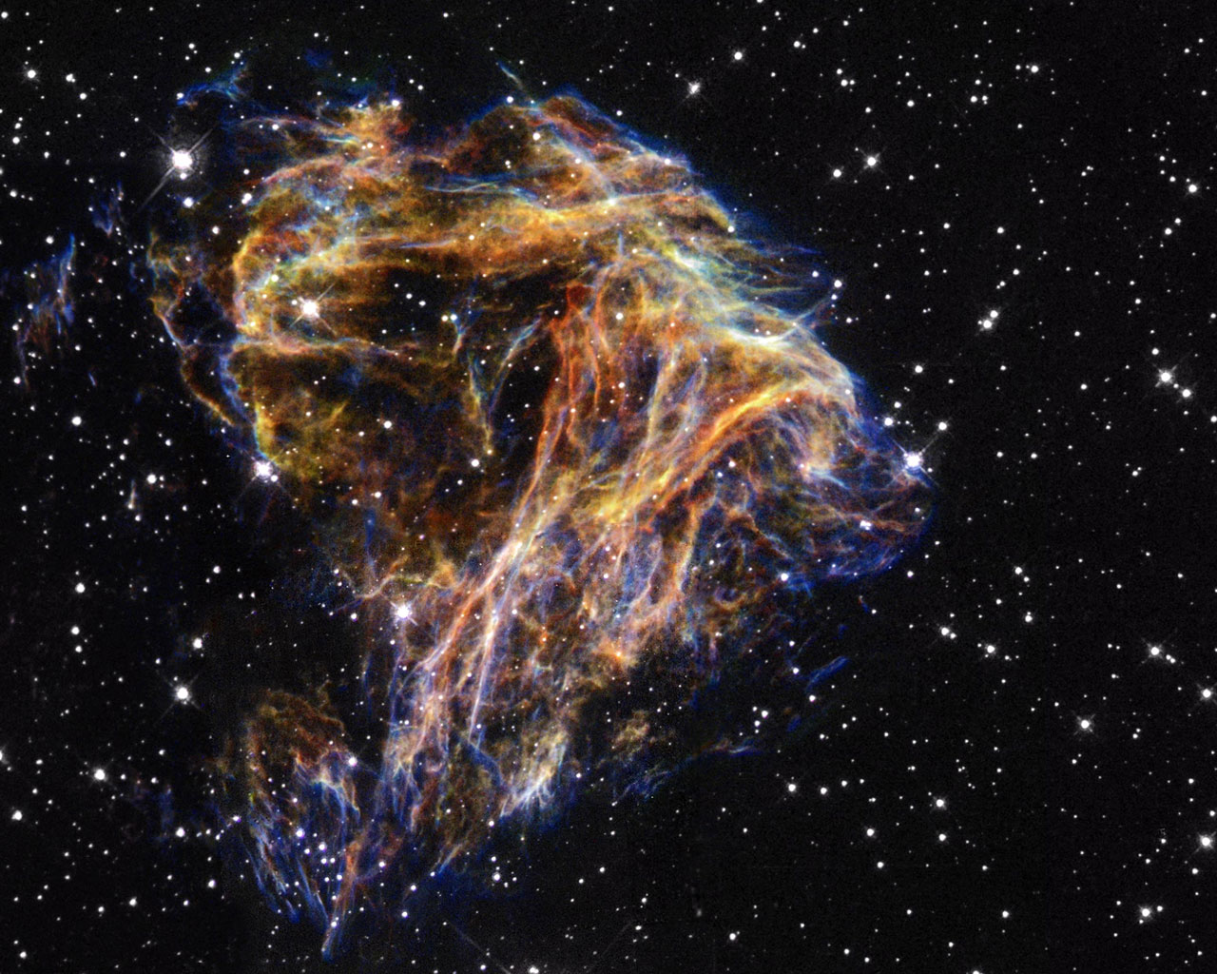
The Eternal Plan
Ephesians 1:3-6
Blessed be the God and Father of our Lord Jesus Christ, who has blessed us with every spiritual blessing in the heavenly places in Christ, just as He chose us in Him
before the foundation of the world,
that we would be holy and blameless before Him. In love He predestined us to adoption as sons through Jesus Christ to Himself, according to the kind intention of His will, to the praise of the glory of His grace, which He freely bestowed on us in the Beloved.
before the foundation of the world,
FREE WILL
Notes:
God purposed that He would have spirit beings that worshipped Him in heaven for eternity before He created man. He put us as spirits Inside these physical containers. Spirit Inside. We are here for this short life to show God that we choose to serve and love Him. That is our purpose and that is God’s purpose in creating us. Heaven is not prepared for just nice people, but people that have proven themselves to love God with all their heart, sould, and mind.
Before God created man he had a plan for man’s redemption.
Why?
If God created man with a free will (the ability to choose to either sin or not sin) doesn’t it make sense that he would make provision in case man sinned? Free will demands it.
That is why He had a plan of redemption planned before He ever created man.
<TR> Another thing we need to look at is our concept of God.

Slide 13

GOD IS HOLY
GOD’S ATTRIBUTES…
OMNISCIENT
(ALL KNOWING)
OMNIPOTENT
(ALL POWERFUL)
OMNIPRESENT
(EVERYWHERE PRESENT)
ARE GOVERNED BY HIS CHARACTER…
Notes:
God’s holiness governs His attributes.
<Job 34 tells us more about His holiness>

Slide 14
Ps 33:4-5
“For the word of the LORD is upright, And all His work is done in faithfulness. He loves righteousness and justice; The earth is full of the lovingkindness of the LORD.”
JUSTICE
LOVE
God’s holiness is demonstrated in His justice and love toward His creation.
Notes:
1 So we do see a God of Justice – He will always be faithful and do what He says He will do.
2 But we also see a God that dearly loves His creation even to the point that – as we will see – He even wants to make provision to help man out of predicaments caused by His justice
<TR> The holiness of God not only sets Him apart but creates a demand and expectation on His relationship with man….

Slide 15



A DESIRED RELATIONSHIP:
SPIRITUAL FELLOWSHIP
WITH A HOLY GOD
Notes:
When man can exhibit the characteristic of holiness God has a union and relationship with man that is called spiritual fellowship.
We are really spirit beings that inhabit these earthly physical bodies. The earthly bodies are temporary and mortal. Our spirit bodies will soon leave these bodies and inhabit the true reality that God has prepared for eternity. This world is the Matrix.
This is why we try to get our kids to be holy.
<TR> This relationship is only possible if man can be found in a state of holiness because this is the only realm of existence with God…but alas this is the problem of man

Slide 16
“Thus you are to be holy to Me, for I the LORD am holy; and I have set you apart from the peoples to be Mine.” Lev. 20:26
God demands moral uprightness in His creatures because He is Holy!
Notes:
So, God expects as much as possible, that we be Holy, as He is holy! God wants a spiritual relationship with us. He is a Holy Spirit and in order for that to occur we must have spirits that been cleansed from sin… somehow . . So we can be holy as well.
This is the idea of SANCTIFICATION – to make holy or set apart before God. Usually connected with having our sins cleansed. We cannot be presentable to God if we have sin present in our lives.
<TR> God expects man, that is made in His image, to be Holy as He is holy. It is possible! That fact is part of the good news! But it is not easy….

Slide 17

God exhibits an attitude of abhorrence and hatred to all that is wrong
Notes:
God is of such purity and sin is such a revulsion that he cannot look upon sin. (Charged filings when confronted with a magnet).
<TR> It is even worse

Slide 18
Sin Separates us from God
“Your iniquities have separated you from your God; and your sins have hidden his face from you.”
Is 59:2
Notes:
God is of such purity and sin is such a revulsion that he cannot look upon sin. (Charged filings when confronted with a magnet).
<TR> It is even worse

Slide 19




SPIRITUAL
DEATH
“you were dead in your trespasses and sins” Eph 2:1
Notes:
That’s why when sin (any sin) separates us from God is described in most drastic terms.
Spiritual Death – (not 5 minutes in the naughty corner for you Supernanny fans)
Our culture continues to diminish sin, while God demands holiness
<TR> This is what Romans 6:23 tells us about the wages of sin…

Slide 20
Romans 3:23
...for all have sinned and fall short of the glory of God
Romans 6:23
...for the wages of sin is death
SIN
DEATH
Notes:
Notice how the terms SIN and DEATH are related
<TR>But here is where the problem gets serious…

Slide 21
The CONSEQUENCES of Sin
SPIRITUAL
DEATH
PHYSICAL
“For out of the dust you were taken; for dust you are, and to the dust you shall return.”
Genesis 3:19
Notes:
– these can be called the consequences or penalty for sin
<TR>When we have suffered the consequences of sin have we done anything that takes care of sin (removes or covers sin)?

Slide 22
The PRICE for SIN
LIFE
DEATH
“without the shedding of blood there can be
no remission of sins.”
Heb. 9:22
no remission of sins
Romans 3:23
...for all have sinned and fall short of the glory of God
Notes:
– these can be called the consequences or penalty for sin
<TR>When we have suffered the consequences of sin have we done anything that takes care of sin (removes or covers sin)?

Slide 23


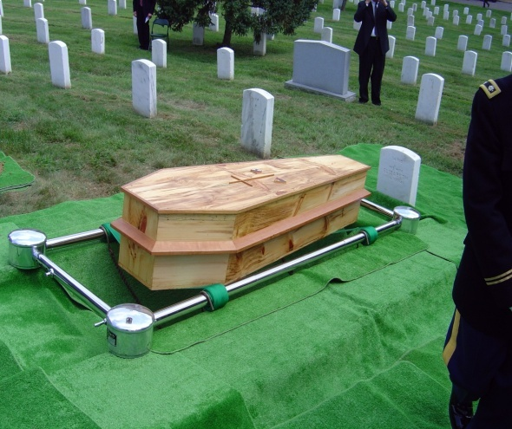

Two Deaths
SPIRITUAL
PHYSICAL
JUDICIAL
CONSEQUENCES
Penalty
Separation
From God
Death of our bodies
Life payment
for sin
Result of individual sin
Result of Adam and Eve’s first sin
Required of every sinner
“The wages of sin
is death”
Romans 6:23
“for dust you are, and to the dust you shall return.”
Genesis 3:19
“without the shedding of blood there can be no forgiveness of sin”
Hebrews 9:22

Slide 24
God’s Justice Demands Death as Payment for Sin
We find ourselves in a very desperate situation:
We have broken the laws of the God of the universe, this has separated us from a Holy God, and the price of death hangs over our head
(which we cannot pay!)
by a just God!
Notes:
The principle so many overlook is that the price for sin is personal – no thing or no one else is responsible for the price for my sin – it is on my head – it is on your head – it is on the head of everyone who sins
Being good will not take care of this problem.
<TR> So man is in a miserable situation. He has a price on his head that he cannot pay. Is there any hope? What is the remedy?

Slide 25
God’s Love Provides a Way to Pay the Price
LIFE!
GRACE
God gives
what is not deserved
(Romans 3:23-26; 5:6-11)
God does not give
what is deserved
(Romans 1:18)
DEATH!
MERCY
Notes:
If we only experienced the JUSTICE of God it would be a short story for all of us.
But the other side of His holiness is His LOVE as demonstrated in His grace and mercy.

Slide 26
MERCY
BLOOD
Notes:
This is where we see that God’s lovingkindness comes in to help man out from the penalty demanded by His justice.
All that blood in the OT is the mechanism that God uses to demonstrate His mercy
This is why the Bible is a book that drips blood. This is what animal sacrifice was all about. It was God’s way to demonstrate His grace or mercy
<TR>Man’s redemption is all wrapped up in the idea of Atonement

Slide 27

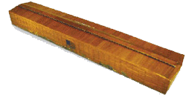
Atonement
Kaphar: to cover, purge, make an atonement, make reconciliation, cover over with pitch
Notes:
Atonement is the mechanism of reconcilation
Atonement is the result of reconcilitation between man who broke God’s laws and God himself so that spiritual reunion can take place.
<TR> And atonement is offered by the blood of animals

Slide 28
Atonement
“...for it is on this day that atonement shall be made for you to cleanse you; you will be clean from all your sins before the LORD” Lev 16:30
SANCTIFICATION
Reconciliation
Notes:
When man can exhibit the characteristic of holiness God has a union and relationship with man that is called spiritual fellowship.
Holiness for man can only take place if the price for sin can be paid thereby removing sin.
<TR> This relationship is only possible if man can be found in a state of holiness because this is the only realm of existence with God…but alas this is the problem of man
<TR> It is even worse

Slide 29
Atonement
Leviticus 17:11
'For the life of the flesh is in the blood, and I have given it to you on the altar to make atonement for your souls; for it is the blood by reason of the life that makes atonement.'
Notes:
Life makes atonement.
One thing we must realize is that God is not a God with some sort of bloodlust. Like the “throw the virgin in the volcano and appease the gods” kind of God.
(Animal sacrifice is another tremendous evidence of God. Every culture in the world, all over the world, has practiced sacrifice. I read that the scholars are puzzled as to how man could have gotten this universal idea that killing something would bring good fortune)
<TR> No. God uses blood (or life) to make atonement due to its representative nature and the seriousness of the crime

Slide 30
Payment
REPRESENTS
BLOOD
LIFE
ATONES FOR
Innocent LIFE
SINNER
REPRESENTS or
SUBSTITUTES for
Guilty LIFE
Innocent LIFE
Heb 9:22 …without the shedding of blood there can be no forgiveness
Notes:
<Sin is bad>

Slide 31


Animal Sacrifice
SINS
(FIGURATIVE)
JUSTICE
MERCY
REPRESENTATIVE DEATH
INNOCENT SACRIFICE
SINNER
SANCTIFIED
DEATH
Notes:
SO here is a visual of how animal sacrifice worked.

Slide 32

What Made it Work?
FAITH
Notes:
The biblical concept of faith is even seen in animal sacrifice.
Couldn’t just believe in animal sacrifice. The animal had to be killed
Heb 9:22
Dad didn’t want to do it because it is raining and cold.
Son does it because dad always did it.
<The Bible is replete with examples of faith

Slide 33
Faith’s Hall of Fame By Faith…
Abel
Noah
Abraham
Sarah
Abraham
Isaac
Israelites
Walls of Jericho
OFFERED
PREPARED
OBEYED
CONCEIVED
OFFERED
BLESSED
PASSED THROUGH
ENCIRCLED
Heb 11
Genuine FAITH requires
Belief-based ACTION
Notes:
Notice what they all had in common
Suppose it was time for anim sac and you decided it was too cold and the lambs had to be chased down and you decided that God knew your heart so you would just skip the yearly sacrifice.
Couldn’t just BELIEVE in animal sacrifice
Likewise, suppose you were killed and your children decided that a yearly sacrifice was a good tradition to keep up without any knowledge of why that animal was killed.
Couldn’t just kill the animal. Had to know why it was being performed.
Believe alone was no good, action alone was no good. Required both.
Naaman is another great example

Slide 34


Genuine Faith – Hebrews 11:6
But without faith it is impossible to please Him, for he who comes to God
must believe that He is, and that He is a rewarder of those who diligently seek Him.
must believe
diligently seek Him.

Slide 35
BELIEF ALONE? (James 2:14-26)
(v14) Can that type of faith save a man?
(v17) Faith without action is dead
(v18) Faith is shown by action
(v20) Faith without action is “useless”
(v21-23) Abraham’s faith was perfected by belief working with his actions
(v24) Justified by action, not “faith alone”
(v26) Faith without action is dead
(v19) Devils are believers!
THERE ARE BELIEVERS IN HELL!

Slide 36
The OT “Teacher”
SACRIFICE
SIN
HOLINESS
GRACE
FAITH
SINS
(FIGURATIVE)
REPRESENTATIVE DEATH
TEACHER
Gal 3:24
ATONEMENT
JUSTICE
MERCY
REDEMPTION
RECONCILIATION
BLOOD
DEATH
REPRESENTATIVE
DEATH
SANCTIFICATION
Notes:
Look at what we’ve learned from OT animal sacrifice.
<TR> Thousands of years go by with millions of innocent animals being slain representatively. Why?
God was preparing for this moment in time.
This is certainly one of the most climatic moments in history.
John the baptist is baptizing and looks up and sees Jesus approaching for the first time and he announces Him….

Slide 37
“Behold the
LAMB OF GOD
that
takes away the sin of the world”
Notes:
There it is. The plan of redemption in a nutshell
Why did he call Jesus an animal?
What was he communicating to the Jewish mind by calling Jesus and animal? Particularly a lamb?
God’s lamb. Did Jesus come to die by accident? Hardly. He was announced to be God’s lamb which meant he had to be God’s sacrifice.
[Explain that OT contains much more information – the promises made to Abraham, the chosen people the Jews, the law and the covenants – but the reason for all of those was ultimately the choosing of His people through Christ]

Slide 38
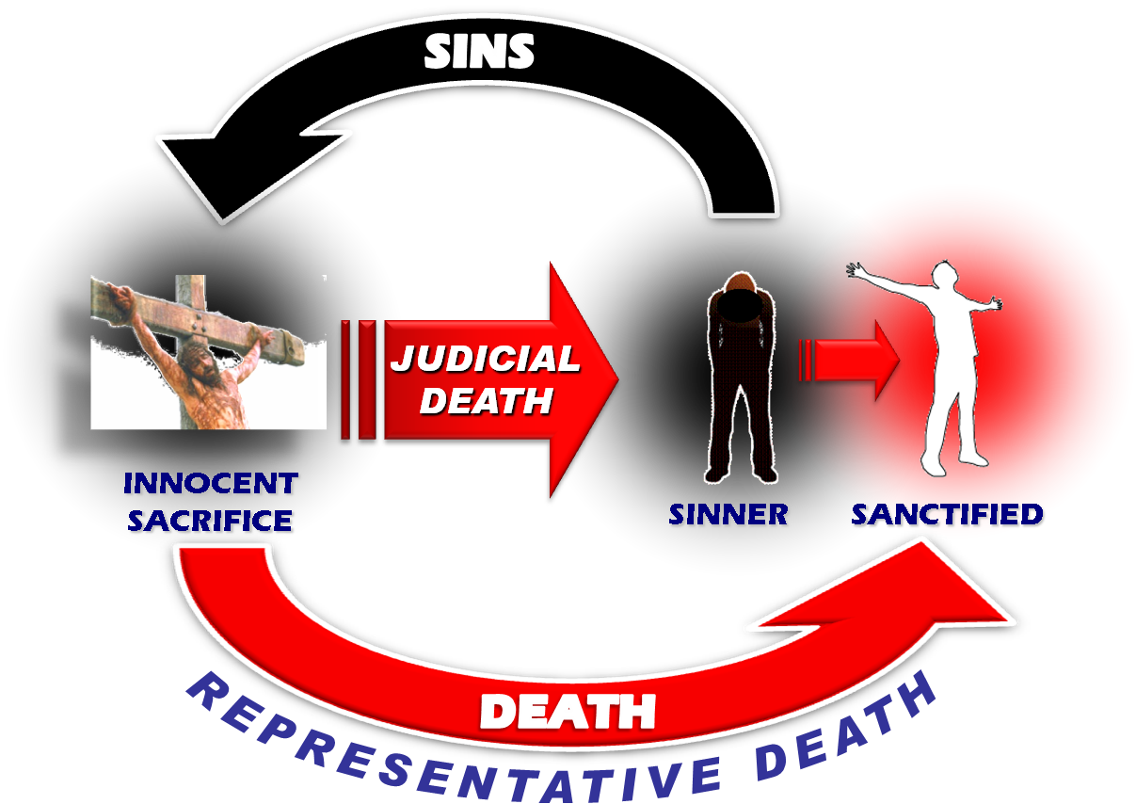
Christ’s Sacrifice – Removes Sin
Romans 6:6
Our old self was crucified with Him,
That our body of sin might be done away with.
Heb 9:22 …without the shedding of blood there can be no forgiveness

Slide 39
An Urgent and Important Command
The great commission –
“Go into all the world and
preach the gospel to all creation.
He who believes and is baptized shall be saved;
but he who has not believed
shall be condemned.
Mark 16:15-16
Notes:
Let’s complete the command of Christ…
This is exactly what we see the apostles carrying out in Acts

