Slide 2
A sincere thank you to all who have contributed their time and talents in many ways to the Children’s Bible Classes
Notes:
I would like to thank the elders for giving me this opportunity to preach about Teaching our Children.
I would also like to take this opportunity to join the many voices who have often spoken from this podium thanking all the Northside teachers. . .Teachers of both the children’s classes AND the adult classes.
This morning, however, my focus will be on the children’s classes. To the teachers of the children’s classes I want to express my appreciation for the time you devote in preparation for teaching and the nurturing you give to your students. Both have a profound affect on them. We all are so very busy, and it is a blessing to have you devote yourselves to this good work time and again. For all the times you have agreed to teach despite a hectic schedule, I am thankful for you. We have 16 classes to fill each and every quarter, and you have been asked to teach one or more of those classes on a frequent basis. I also am grateful for your willingness to sub and to assist in the Nursery class.
I am thankful for Ryan Hall who has hung white boards, bulletin boards and maps, readied the chronology walls, provided sound proofing where needed and hung the intelligent design poster boxes which were used by Kristin for the intelligent design classes.
I am also thankful to those of you who have written over 390 lessons to correlate with the Bible Study Guide, and for those of you who have assisted in coloring, painting, cutting, and sewing materials to be used in the younger classes.
If there are any here who do not wish to teach but would like to help with the children’s classes in other ways, we are always looking for help with readying materials.

Slide 3
Teaching our Children
The Role of Parents and Bible Class Teachers
Notes:
For the lesson this morning, I have gleaned material from the book: A Generation That Knows Not God by Bob and Sandra Waldron.
This morning we will be looking at the roles of parents and Bible Class teachers in Teaching our children.
The primary responsibility for teaching children lies with the parent. We will look at some passages from the Bible later in the lesson that speak to this. The Bible class teachers can and should be helping parents in the task of teaching the Bible, but their time is limited. They need your cooperation to make their work effective.

Slide 4
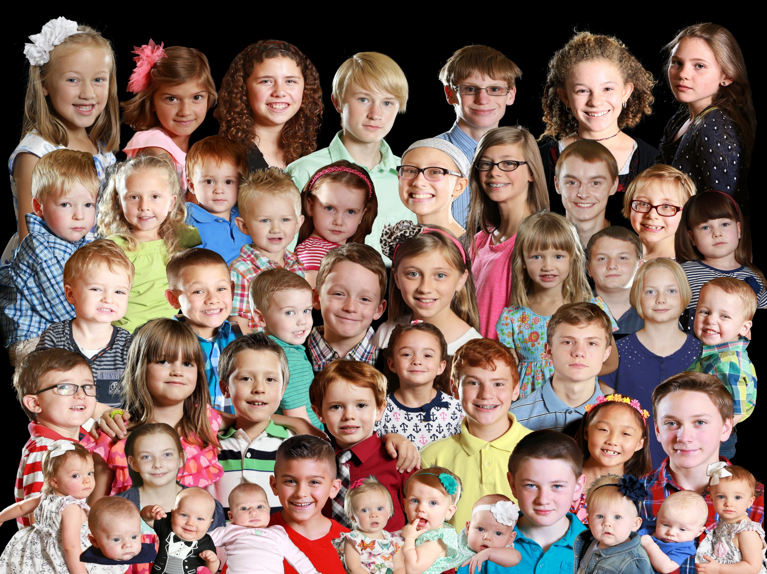
Notes:
As members at Northside, we are blessed with a large number of children as part of our spiritual family! Children of all ages who bless our lives in countless ways with hugs, love, and laughter. And as adult members, we have a special privilege and responsibility towards these children: to give them knowledge about our Lord and Creator and to stir their hearts with the mighty works of God.
Moses spoke about this great responsibility in Deuteronomy, before the children of Israel entered the land:

Slide 5
A Responsibility Given
Deut. 4:9
“Only give heed to yourself and keep your soul diligently, so that you do not forget the things which your eyes have seen and they do not depart from your heart all the days of your life;
but make them known to your sons and your grandsons.”
Notes:
Read slide
Those who had seen God work wonders in their life, had a commanded responsibility to pass down the wondrous events they had seen to the next generation – to make those events come alive in the hearts of their children and children’s children.
Our eyes have not seen but we can see and experience God’s mighty works through the eyes of those who did see.
Some key points here:
“Do not forget” “do not depart from your heart all the days of your life” (this takes work) – I think sometimes we tend to overlook this – we learn but what are we doing so that we do not later forget?
God’s mighty works were to be made known to succeeding generations.
Interesting that grandchildren are included – This responsibility of teaching was also given to grandparents.

Slide 6
Through the Eyes of Moses and Joshua
Joshua 4:21-24
God’s mighty work allowing the Israelites to cross the Jordan river into the promised land.
God’s mighty works were not just for the people of the day
God’s mighty works are to be told to each
succeeding generation
Notes:
We were not there, but we can see and experience through the Eyes of Moses and Joshua
Read Joshua 4:21-24
²¹ And he said to the people of Israel, “When your children ask their fathers in times to come, ‘What do these stones mean?’ ²² then you shall let your children know, ‘Israel passed over this Jordan on dry ground.’ ²³ For the Lord your God dried up the waters of the Jordan for you until you passed over, as the Lord your God did to the Red Sea, which he dried up for us until we passed over, ²⁴ so that all the peoples of the earth may know that the hand of the Lord is mighty, that you may fear the Lord your God forever.”
God’s mighty works were something to be impressed upon the children of the Israelites – each child was to know the power of Jehovah just as vividly as those who had seen the Jordan River part with their very eyes.
While we may not have seen the children of Israel exit Egypt or the Jordan River part with our own eyes, we can see it through the eyes of Moses and Joshua.
God’s mighty works were not just for the people of the day
They were to be told to each succeeding generation.

Slide 7
Through the Eyes of the Apostles
and the Holy Spirit
John 20:30-31
30 Now Jesus did many other signs in the presence of the disciples, which are not written in this book; 31 but these are written so that you may believe that Jesus is the Christ, the Son of God, and that by believing you may have life in his name.
Notes:
We were not there but we can see and experience through the eyes of the Apostles and the Holy Spirit
Read John 20:30-31
While we may not have physically seen salvation made possible through Christ on the cross, we can see it through the eyes of the Apostles and the Holy Spirit.
And God’s works do not stop there – each and every one of us has been shaped, touched, and transformed by God in some wondrous way. God does answer prayer. Each of us has seen God work in our life. It’s our job to make God, His mighty works, and His perfect word come alive to our children!
Make the Bible come alive!

Slide 8
Teaching in the Home
Eph. 6:4; Deut. 6:7-9
“Fathers, do not provoke your children to anger, but bring them up in the discipline and instruction of the Lord”
“You shall teach them diligently to your sons and shall talk of them when you sit in your house and when you walk by the way and when you lie down and when you rise up. You shall bind them on the doorposts of your house and on your gates.”
Notes:
God’s word makes it clear that parents have the main responsibility for teaching their children. The main source of a child’s spiritual teaching should be in the home. Paul tells us, in fact, that it is ultimately the father’s responsibility although we recognize in many cases the mother is the one with the most time with the child.
Read Eph. 6:4
Regarding the words of the law, Moses told the people:
Read Deut. 6:7-9
This takes time (let me emphasis here ) time spent with the child.
Bible classes twice a week cannot have that type of impact, but parents can!

Slide 9
Teaching in the Home
Each time a parent sits down to teach their child (A Bible class workbook, their own lesson, spur of the moment observation relating to a Biblical truth) they are teaching a lesson not only for that day,
but for a lifetime – and for all eternity.

Slide 10
A Child’s Life in Balance
Parents
School
Peer
Pressure
Personality
Society
Church
Services
Bible
Teacher
Notes:
To emphasize what we have just said, let us look at the following. (Chart from A Generation that Knows Not God)
The Child’s life is in a balance with many, many influences that can be put on a scale.
Here we see listed on the chart Parents, School, Peer pressure, personality, society, church services, Bible teacher.
As a factor of time only - in this chart the parents have the most time and the Bible teacher the least.
Some of the influences listed here are good, but many of them are bad. Which way will the scales tip?
As you can see the biggest potential good influence is in the home. If a significant amount of Bible teaching at home is not taking place, our children’s education will be fundamentally unbalanced. The Bible classes at Northside are meant to be viewed as a supplement to our children’s spiritual education at home, not as a replacement.

Slide 11
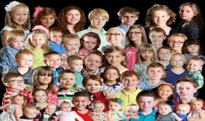
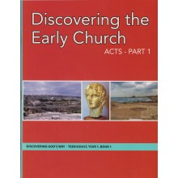
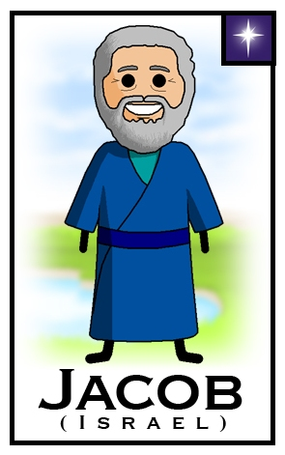
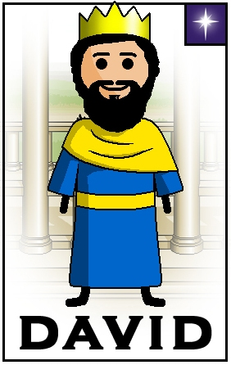
Workbooks in Use for this Quarter
Bible Study Guide Supplement:
Northside Church of Christ : Take Home Lessons
Year 4; Book 2
My
Take Home
Book
Lesson content for this quarter includes
Paul’s apostleship as well as practical teachings for our lives
“Be kindly affectionate to one another with brotherly love, in honor giving preference to one another;
Romans 12:10
(Lesson 359)
Studies in
Acts,
Romans,
1 Corinthians,
2 Corinthians,
Galatians
OT Part 2
OT Part 2
http://www.clipartbest.com/reading-bible-kids-clipart
Winter Quarter Ruth to Ezra & Nehemiah
Bible Study Guide Supplement:
Northside Church of Christ : Take Home Lessons
Year 2; Book 2
Jacob
&
David
Notes:
If you have a child in the Bible classes, You should recognize one of these workbooks being used this quarter. Are you seeing to it your child comes prepared for class? For the lower grades a parent will need to sit down and help the child. Once a child is reading and writing and handling homework from school, they should take on more of the responsibility for completing the workbook lesson. But at all levels, parents need to be encouraging students as to the importance of these lessons being completed at home.
The workbooks are an integral part in the task of learning and remembering – they are not to be viewed as optional. For example: The lessons in the BSG workbooks for (k/1 – ¾) are an overview of the lesson they are to study in class. In order for them to effectively learn the lesson in class, it is important they get this overview at home first.

Slide 12
Parents and Bible Class Teachers Working Together for Effective Bible Classes
Parents
Please have your child on time for class
Know what your children are studying
Assist children with workbook in lower grades
If they have lost their book – ask for another
Be aware of assignments that are made
Encourage your child to do their work on time
Encourage the children to do their best
Cooperate on suggested class projects
Notes:
The Bible class teachers need your cooperation to make their work effective. Be on time for class. Know what your children are studying. If they have lost their book ask the teacher for another. Be aware of assignments that are made, and encourage your child to do their work on time. Children tend to forget some assignments and to be negligent in completing others. Encourage the children to do their best and cooperate to the fullest on suggested projects.

Slide 13
Parents and Bible Class Teachers Working Together for
Effective Bible Classes
Teachers:
This will be covered in the Workshop
January 16 9:30 to 11:00
January 30 9:30 to 11:00
Notes:
I will talk on the role of the Bible class teacher in the Workshop
If you are teaching/have taught/or are considering teaching, please sign up for one of the workshop dates if you have not done so. It is important that all teachers attend because the workshop in January is the foundation for subsequent grade level meetings.

Slide 14
Train up a child in the way he should go; even when he is old he will not depart from it.
Proverbs 22:6
Notes:
Keeping things in perspective:
Proverbs 22:6 Here we see the positive consequences of teaching
Read
A common quote I have seen tells of the negative consequences of not teaching:
“If we don’t teach our children to follow Christ, the world will teach them not to.”

Slide 15
A Child’s Life in Balance
Education (K – 12th)
Bible Class(1xWK) Secular
663 Hours 18,200 Hours
Bible Class(2xWK)
1326 hours 18,200 Hours
Notes:
Lets take a Look at the big picture:
What is the long term investment in time for children to attend Bible classes during their most formative years?
When we consider all that is required in a child’s secular education, are our expectations for Bible class too low?
Let’s take a look at the chart. Compared to the amount of time spent in secular education Kindergarten through High School (which is 18, 200 hours),
is 1,326 hours (Bible Class 2x a week) unreasonable?
Keeping things in perspective: How does the value of lessons taught in the Bible classes compare to those taught in secular education?
It will take effort to keep a child’s life in balance. We need to find the time.

Slide 16
One of the Aims of Teaching God’s Word
To Know the Whole Counsel of God
Acts 20:27
“For I have not shunned to declare to you the whole counsel of God. “
Every book, every story, every lesson is there for a reason.
Notes:
Paul knew it was essential to preach all of God’s word to the Ephesians, not just parts. Every book, every story, every lesson is there for a reason. Our children can learn from Jehoshaphat as well as from Noah. From Nehemiah as well as from David. It is essential that our children have a well-rounded knowledge of the entire Bible on which to begin building their faith. Jesus said “And you shall know the truth, and the truth shall make you free” (John 8:32). Knowledge of that truth – that entire truth – is key to raising up our children with the goal of them obtaining that freedom through Jesus. Our job as teachers is to help our children build that all-important foundation of knowledge. Without knowledge, without hearing the word of God, there can be no faith (Rom 10:17). Having a planned, organized Bible class program seeks to ensure this is the case and helps to prevent any gaps in our children’s knowledge of God’s word.

Slide 17
To Grow Up in All Things into Christ
Ephesians 4:11-15
Role of the teacher is provided
Put children on that path
Impart knowledge needed to grow faith
Encourage and nurture that faith
A Standard to be followed
Grow up in all things into Christ
Continue to grow
Know error and confront it
Notes:
Read Ephesians 4:11-15
11 And he gave the apostles, the prophets, the evangelists, the shepherds[a] and teachers,[b] 12 to equip the saints for the work of ministry, for building up the body of Christ, 13 until we all attain to the unity of the faith and of the knowledge of the Son of God, to mature manhood,[c] to the measure of the stature of the fullness of Christ, 14 so that we may no longer be children, tossed to and fro by the waves and carried about by every wind of doctrine, by human cunning, by craftiness in deceitful schemes. 15 Rather, speaking the truth in love, we are to grow up in every way into him who is the head, into Christ,
Along with other roles, Paul tells us that God provided for the role of a teacher to help us achieve a high standard. What is that standard? To grow up in all things into Christ – to continue to grow in knowledge, faith, and spiritual stature such that we constantly strive to be like Christ in all things. What a goal to aim for! As teachers, it’s our job to put children on that path, first imparting the knowledge needed to build faith and then, as they grow, encouraging and nurturing that faith and spiritual stature. As parents, are we committed to this high standard? As teachers, are we committed to this lofty goal? The overarching goal for any children’s Bible class program must be the salvation of our children’s souls. Nothing concerns a parent as deeply as their child’s spiritual future and nothing brings greater joy to a parent than to see their child on the path to salvation. “I have no greater joy than to hear that my children walk in the truth.” 3 john 4. (context of this verse speaking about children of faith – but the same joy applies to our child as they grow in knowledge of Christ as well).As teachers, we have an awesome responsibility placed upon us. Bible classes working in concert with dedicated parents and loving Christians, will help save the souls of students!

Slide 18
The Importance
of Having Goals
Notes:
The Importance of having Goals
When considering how to approach structuring Bible classes for the children at Northside, it helps to think in broad terms. What should a child who has been in Bible class from age 2 to age 18 have learned? Without a goal or standard to aim for, it’s all too easy for students to progress physically from class to class without progressing in their knowledge. How do we determine what our standards should be in teaching our children?
The handouts you have received were developed by Rick Lanning, an evangelist I’ve known for many years. I have slightly modified them. They are a starting point going forward and will be further developed as needed.

Slide 19
Goals for Children in:
Kdg/1st
1st/2nd
2nd/3rd
3rd/4th
Knowledge Bible Study Skills Attitudes Behaviors
Recite all books of the Bible
Bible TIMELINE (knows well)
Work on lists:
The Apostles
The Patriarchs
The Days of Creation
The Ten Plagues
The Ten Commandments
Judges
Kings
Prophets
Basic Bible Geography
(find event and story
locations on map)
Godhead (characteristics)
Father (love, wrath)
Son (God, man, savior)
Holy Spirit (revelation)
Cultures
Jews, Samaritans, heathen idolaters, etc.
Bring Bible and lesson book
to class
2. Find all Bible books quickly
Distinguish between OT
and NT (know why we have
both)
Reverence for God in
Bible class and worship
Good self-image because
very special to God
3. Valuable part of
class, family, worship
services
Responsibilities to God,
family, church, neighbors
Importance of the Bible’s
authority . . . answers
all our questions
Golden Rule: Matthew 7:12
Rejoice in Jesus the Lord!
Humility to repent or
admit wrong
Develop good relationships
with everyone – show no
partiality
2. Kdg through 2nd:
Parent involvement to
ensure lesson is read
prior to class
3rd /4th:
Lesson read/completed
prior to class
3. Daily habits of prayer and
Bible devotions (Encourage
whole family involvement)
4. Accept responsibility for
own wrong
5. Encourage participation
in worship services
singing, notes on sermons, giving
6. Respectful language and
actions towards
parents, elders, teachers, etc.
Notes:
These charts list a series of goals that we will strive to achieve for each class/age group. Hear you see the goals for the classes using the Bible Study Guide Curriculum. This is a 4 year curriculum. Tthe goals outlined on this sheet are for the K-1/1-2/2-3/and 3-4 classes.
The goals are broken into the following categories:
Knowledge – facts the children in the class should know by the time they leave the class
Bible Study Skills – skills the children should possess to help them in their next level of Bible study
Attitudes – thoughts and stances the teacher should be reinforcing with each child
Behaviors – social and behavioral skills taught and practiced in the classroom.
Both teachers and parents working together can address these goals:
Teachers:Spend at least a small portion of every class period developing and reviewing these skill sets with your students.
Parents: It’s also important that parents help the teachers in assisting their children reach these goals.

Slide 21
Our Goal as Parents
and Teachers
Teach to the very best of our ability
Notes:
In talking with Beth’s dad last week he remarked what a great number of children we have in the congregation but with that comes great responsibility.
Bob and Sandra Waldron speak to this responsibility at the end of their book:
“Teaching is an awesome responsibility, but it is one God says we can accomplish. Let us accept the challenge before us and teach all those around us to the very best of our ability. That is all God asks – but He does ask that much!”

